Slide 1

PREDICTING INTERSTATE AFFINITY USING MACHINE LEARNING
Alden Felix, Wei-chen Huang, Jim Pan, Samuel Adelusi

Slide 2
AREA/TOPIC
Inspired by Dr. Vito D'Orazio – predicted violent conflict in Africa using machine learning models
Wanted to generalize globally
Predict inter-state affinity with machine learning using political, social, economic. and demographic data

Slide 3

Event/Affinity Data
Integrated Crisis Early Warning System
ICEWS: Integrated Crisis Early Warning System from Harvard Dataverse from January 1, 1995, to April 11, 2023
Affinity score computed from intensity found in event data

Slide 4
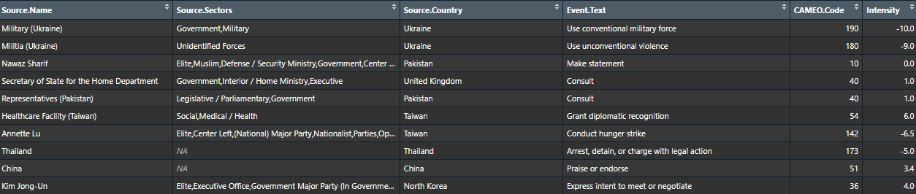
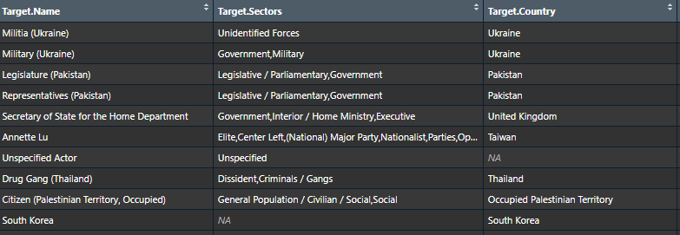
Coded Event Data

Slide 5
Socioeconomic Data
World Bank
World Development Indicators
Education Statistics
Gender Statistics
Health Nutrition and Population Statistics
Doing Business (Objective measures of business regulations and their enforcement)
International Monetary Fund
Freedom House
Trade data
Freedom scores

Slide 6
METHODS
Dependent Variable
Continuous – affinity score from coded event data
Categorical – affinity scored converted into categories from -1 to 3
Random Forests
Continuous – Regression
Categorical – Classification
Deep Learning
Categorical – TensorFlow classification
Possible overfitting and little insight using shap library

Slide 7
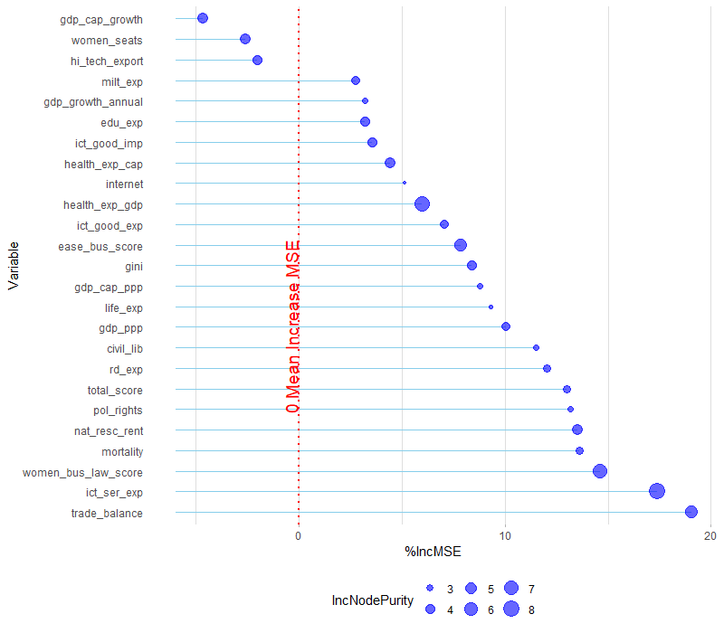
Random Forest Regression

Slide 8
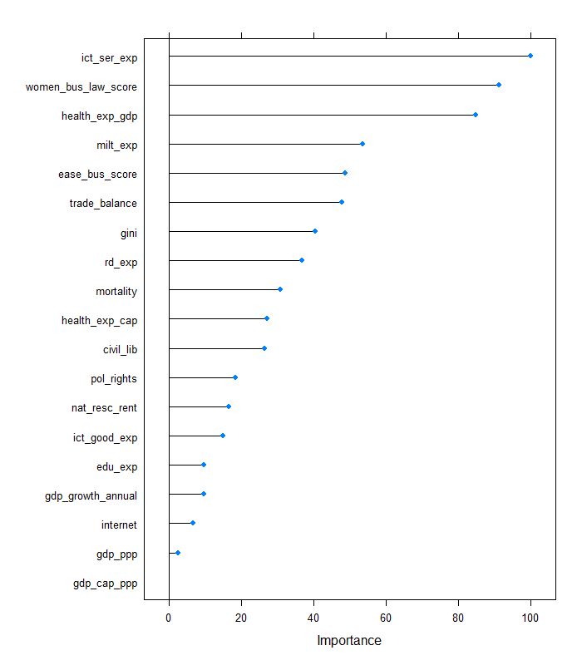
Random Forest Regression: R² = 0.27

Slide 9
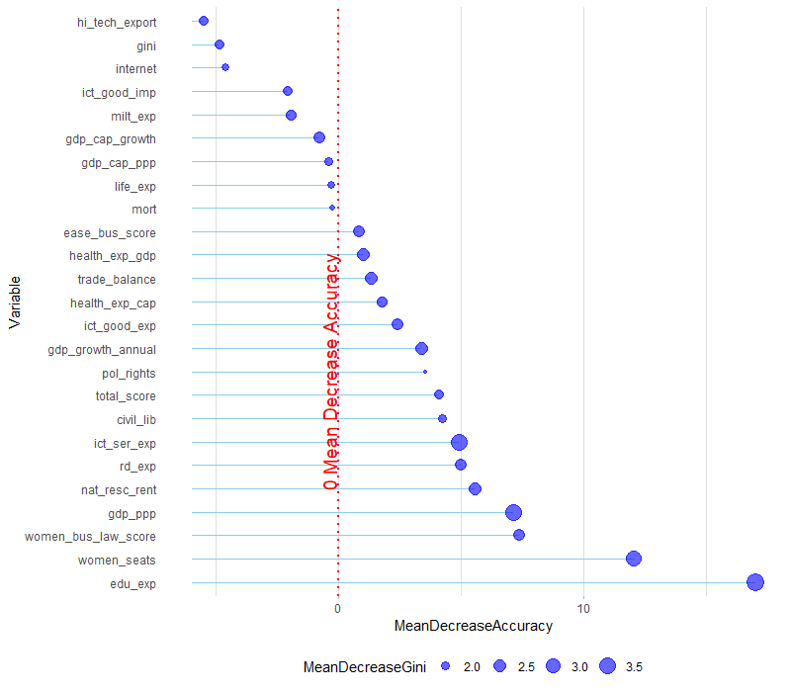
Random Forest Classification

Slide 10
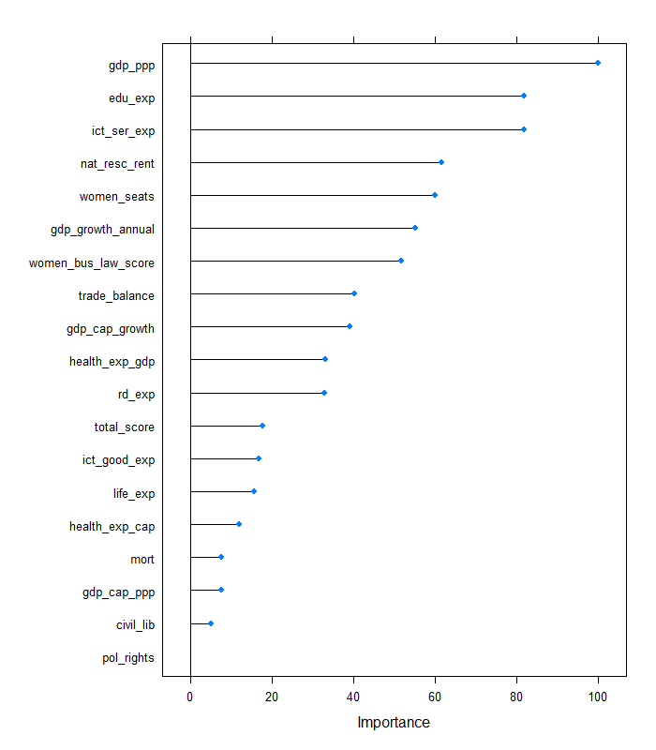
Random Forest Classification: R² = 0.43

Slide 11
Variable Importance between Classification & Regression
Regression
Classification

Slide 12
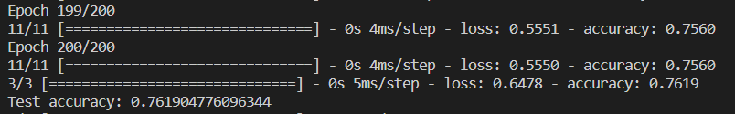
Random Forest Classification: R² = 0.76

Slide 13
Future Improvements
Current Model
Improved Model
Simple affinity calculation
Clustering/Network methods to derive affinity communities (Pauls et al., 2017)
ICEWS Coded Event Database
POLECAT Database
Imputed independent variables and scope of variables
New sources of socioeconomic and demographic data

